Slide 1
Cloud, DevOps & Application Secrets Management
Notes:
Today I’ll be talking about securing privileged access in the cloud at scale, and managing secrets within the DevOps Continuous Integration and Deployment Pipeline.

Slide 2
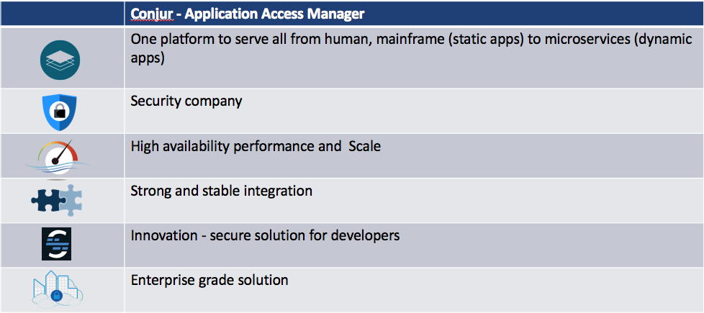
Cyberark: the only security vendor in devops

Slide 3


Everybody wants a secure DevOps flow, but…
Developers
Security
Good USER EXPERIENCE IS IMPORTANT!
So is collaboration!
Notes:
Show me the Dev$ecOp$
https://youtu.be/com/EMN47OtIhS0?t=5863

Slide 4
SHIFTING SECURITY LEFT INTO DEVELOPMENT WORKFLOWS
Plan
Code
Operate
Create
Test
Release
Deploy
Enable Developer/DevOps
Easy to use (consume secrets)
Prebuilt integrations
Open source and Secretless
Free developers from security burden
Compliance, audit requests, human creds
Security budget
Empower security team
Highlight the app & tool risk
Leverage single platform – human/non-human solution serves all
Security focus
Manage security budget
Developers
DevOps
Security

Slide 5









THE PROBLEM WE’RE SOLVING
There are lots of places to store secrets.
But:
Platform solutions only work for those platforms
Tool solutions lack security
Most not enterprise ready
Hard to share best-practices
SoD not enforced
GRC reporting is impossible
Home Grown Solutions
Islands of Security
Secrets
Secrets
Hiera
Vault
Databags
IAM / KMS
IAM / KMS
IAM / KMS

Slide 6




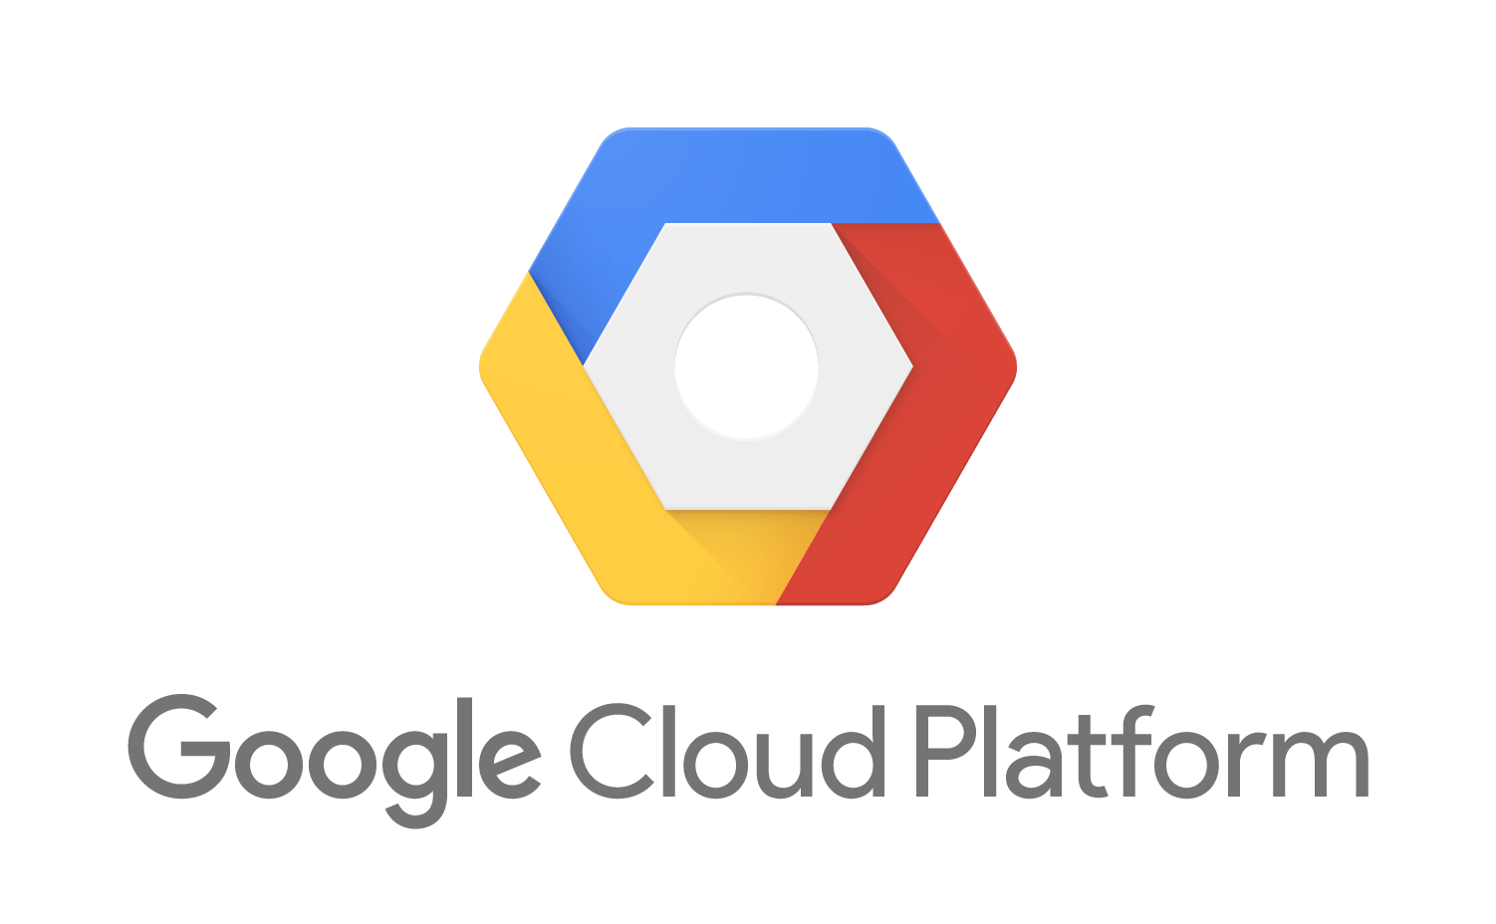
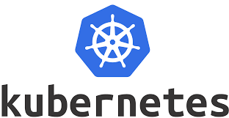








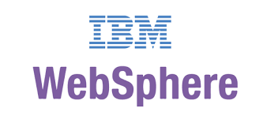





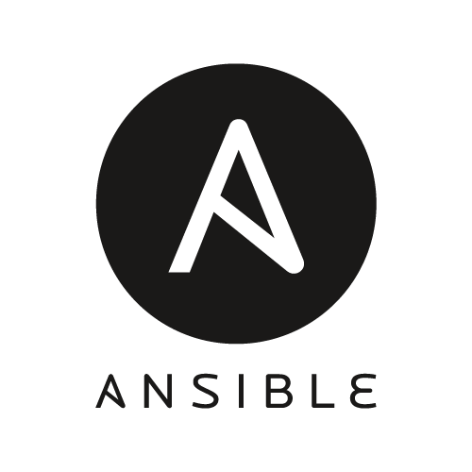





THE VISION WE’RE DELIVERING ON
Consistently enforce privilege security policies for both human users and non-human identities
Enterprise-Spanning Service delivered by IT Security
PAS
On-Prem Infrastructure and Apps
(*NIX, Windows, zOS)
IaaS
PaaS
DevOps Tools
App Servers and Custom Apps
Security
Solutions
IT Mgt
Software
RPA
Notes:
Only CyberArk offers an integrated solution for credentials and secrets management, regardless of the compute or development environment. Using a single control point to enforce consistent privileged security policies across the enterprise is a best practice for CISOs and IT leaders. And it’s something that we’re increasingly hearing from Gartner, Forrester and other analysts.

Slide 7









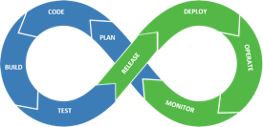
Centralized Audit, Security Policy, & secrets Rotation
CyberArk
Vault
Consistent, Unified Enterprise-Wide PAS Program
Multi-Persona UI
PVWA
Conjur
Application Access Management
Privileged Threat Analytics
CPM
PSM, OPM
Credential Providers
– Agent-based
Credential Providers
– Agentless

Slide 8







Cyberark secures the entire Chain of Trust
Human Engineers
(Root)
Platform Access
Build/Test
Config/Deploy
Tools & Automation
(Intermediates)
Pre-Prod
Production
Version Control
Test Environments
Artifact Repository
On-Prem
Cloud
Apps & Target Systems
(End Entities)
Target Systems
Target Systems

Slide 9
Cyberark secrets management (CSM) – 4 solutions
Agent-Based
Credential Provider (CP)
Architecture: Local agent on host w/ app
Best use: Long-running, monolithic apps
Application Server Credential Provider (ASCP)
Architecture: Local agent in app server
Best use: WebSphere, WebLogic, Jboss, or Tomcat Java apps
Agentless
Central Credential Provider (CCP)
Architecture: Central server (CP + IIS)
Best use: Multiple, distributed apps
Conjur Secrets Manager (FKA Conjur)
Architecture: Multi-node cluster (Docker containers)
Best use: CI/CD tools, micro-service/cloud/K8s apps

Slide 10
Architecture

Slide 11
Cyberark Secrets management - solution architectures
Agent-Based
Agentless
app
SDK
app
REST
CP
CP
script
script
CLI
REST
CyberArk
Vault
Credential Provider
Central Credential Provider
J2EE App Server
CP
DS
Application Server Credential Provider
Conjur Enterprise

Slide 12
Conjur secrets manager - solution Architecture
Secrets Updates
Enterprise Vault
(system of record)
Audit Updates
Synchronizer
P
Primary/Standby
(update availability)
S
Followers
(service availability, scalability, accessibility)
F
F
Build Automation
Deployment Automation
Infrastructure Automation
Applications
Applications

Slide 13
Conjur secrets manager Architecture – example
Enterprise Vault
Synchronizer
DR
DC
P
HA cluster
S
S
Async
Sync
S
LB w/ Health check
Cloud
OpenShift
/ k8s
F
F
F
F
LB
LB
CI-CD Tools / Applications
CI-CD Tools / Applications

Slide 14
Authentication

Slide 15



If it can be identified, its access can be managed
Build on a chain of trust
Authenticate all requests
Authorize w/ least amount of privilege
Audit everything
...and do it with code!
The Secret-Zero Problem…
Humans have built-in authentication support:
Built-in vault for passwords
Back-channels for MFA (e.g. phones)
Non-humans need a way to bootstrap identity authentication that doesn’t put credentials at risk
But how to manage that initial secret required by apps to bootstrap identity?
Human Identity
Workload

Slide 16
Ways to establish & authenticate Identity
 | Use-Case | Means | Strengths | Weaknesses
Credential Based | Human identity | Passport, Password | Very familiar Humans have built-in vaults | Social engineering Insecure persistent storage
 | Pre-Configured Identity | API Key | Analogous to human uname/pwd model | Key distribution is subject to compromise Requestor can’t initiate
 | Bootstrapped Identity | Token-based | Can provide extra control factors, e.g. time, CIDR, one-time use, etc. | Secret to get a secret Stateful - requires active entropy mgmt
Attribute Based | Human Identity | Biometrics | Hard to spoof Convenient | Context dependent
 | Pre-Configured Identity | Various Factors | Multi-factor (selectable) OS user, path, MD5 hash, IP/Hostname | No trusted 3rd party Requires authn agent running local to applications Not scalable to container use-cases
 | Bootstrapped Identity | Trusted 3rd Party | Ideal for container orchestration | Platform dependencies Hard to implement for legacy technologies

Slide 17



Secrets Access Workflow
Requestor
Conjur Follower
Target
Authenticate
Access Token
Access per Policy
Retrieve secrets
Use secrets
Access Token expires after 8 mins
Audited activity

Slide 18



K8s attribute authentication in
1
Admin whitelists app identity with Conjur
Two options for identity granularity:
Identity = Cluster/Namespace
Identity = Cluster/Namespace/Service Account
Authenticator client in app pod submits CSR w/ platform attributes to Conjur
Conjur verifies attributes w/ platform service
Conjur issues cert & key creds to authenticator client in app pod
Authenticator client in app pod uses creds to authenticate, get Conjur access token and shares via shared memory volume.
identity
Conjur policy
2
csr
4
5
3
verify
access token
Notes:
K8s secrets risks: https://kubernetes.io/docs/concepts/configuration/secret/#risks

Slide 19

IAM role authentication in
1
Admin whitelists app identity with Conjur
Identity = app name + account # + IAM role
App gets signed header from platform service
App submits identity & signed header to Conjur
Conjur verifies header w/ platform service
Conjur issues Conjur access token to app
identity
Conjur policy
3
identity
header
5
access token
4
header
2
header

Slide 20
Managed Identity authentication in
1
Admin whitelists app identity with Conjur
Identity is a name annotated with:
Subscription + Resource Group
Subscription + Resource Group + System-Assigned Identity
Subscription + Resource Group + User-Assigned Identity
App gets Azure access token (JWT) from IMDS
App submits identity & JWT to Conjur
Conjur verifies token w/ STS endpoint for tenant
Conjur issues Conjur access token to app
identity
Conjur policy
3
identity
jwt
5
access token
4
jwt
Metadata Service
2
jwt

Slide 21
Integrations

Slide 22
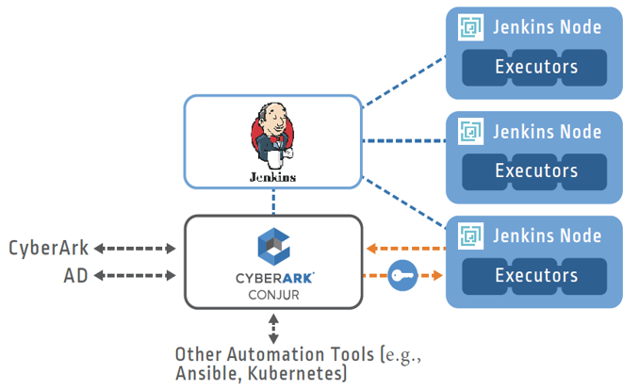

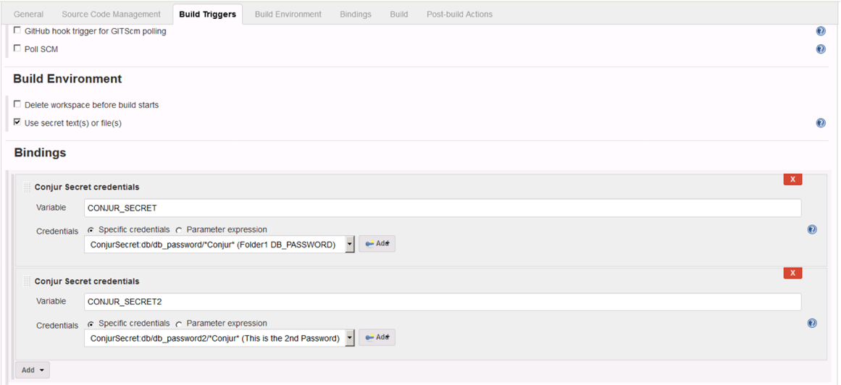

Orchestrating the pipeline
Utilize recommended best practices with jenkins
Use Jenkins Pipelines to your advantage
Ephemeral Jenkins Slaves (Executors) via Docker
Utilize Kubernetes or OpenShift as much as possible
This allows for attribute-based authentication, no secret zero!
Establish Machine Identity on Ephemeral Nodes
Use Credentials Plugin for Secure Secrets Delivery
Notes:
Go in-depth with Conjur vs. AIM and why.why not

Slide 23
OpenShift/Kubernetes Integration
Securely provide secrets to applications
Seamlessly integrates into the OpenShift/k8s environment
Strong container authentication based on its attributes
Central audit
Secret rotation
Notes:
Low maintenance using wrapper or init container solutions – no need to care about re-login when secrets rotation

Slide 24
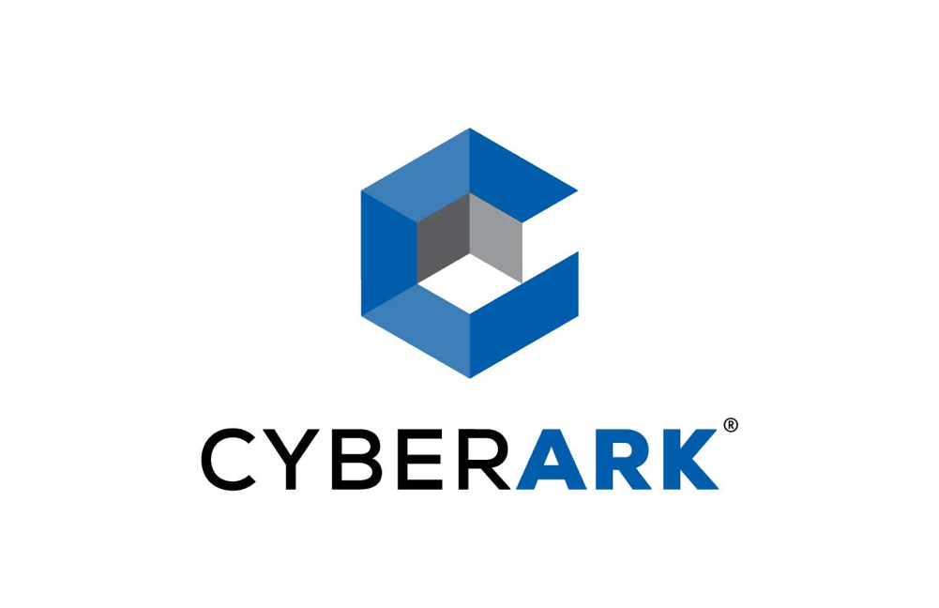
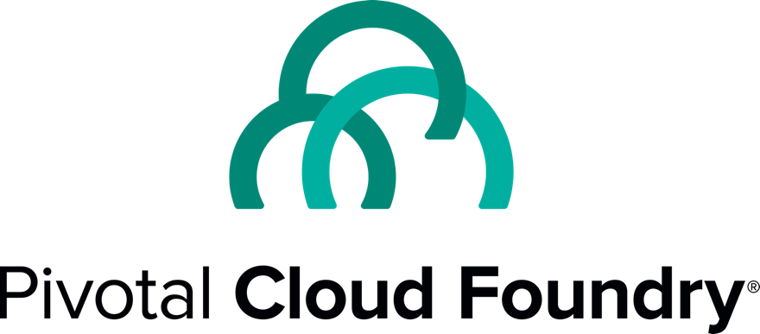
Partners in Enterprise Security
Both organizations are focused on best in class security solutions for Pivotal Cloud Foundry deployments and workflows.
Strong partner relationship and many shared customers.
Solution developed in collaboration with Pivotal R&D.
Notes:
Key takeaway: CyberArk and Pivotal are working together to secure Pivotal Cloud Foundry.

Slide 25
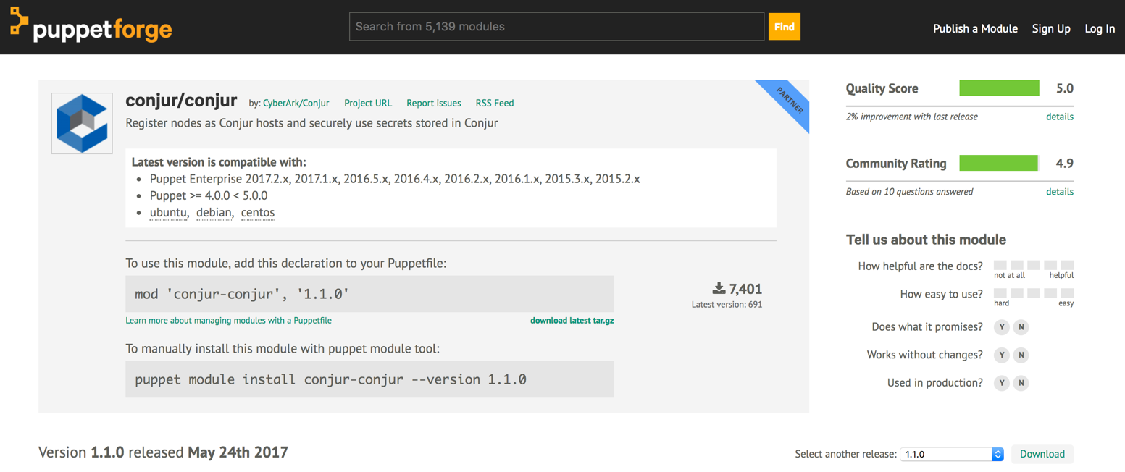
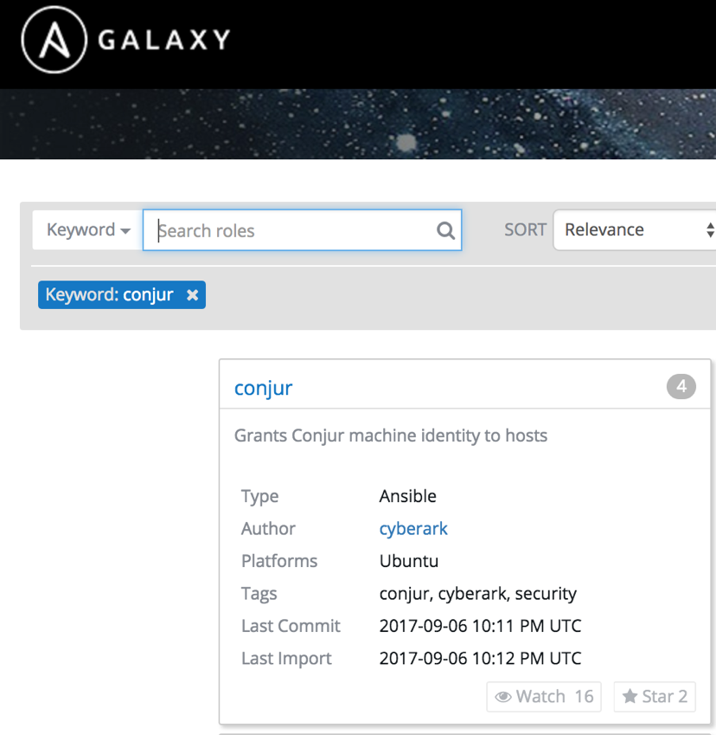
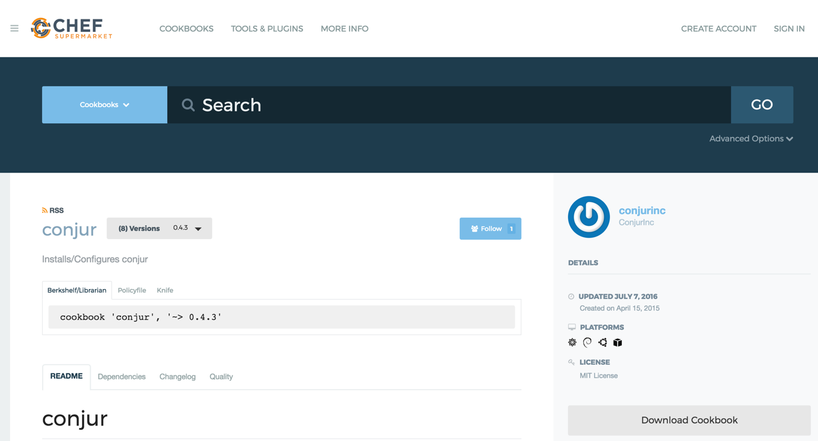
Example CI/CD Integrations: Config Management

Slide 26


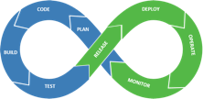



Aqua Security – CyberArk Conjur Integration No container downtime or restart
Conjur
Discover embedded secrets in images & containers
Securely inject secrets into runtime containers (no container downtime/restart for business continuity)
Encrypt secrets in transit and in memory (never persist on disk)
Secrets visible inside the container only, not visible to host or orchestrator
Rotate secrets with no container downtime/ restart
Manage, monitor, and audit container access to secrets
Enable secrets segregation by assigning labels (e.g. namespaces) to secrets and create security policy to allow only specific workloads to use specific secrets based on labels
Automatically provision, secure, and manage secrets
Registries
CI/CD
Cluster
Image Scanning
RBAC
Secrets
Image Assurance
Runtime Protection
Container Firewall
Compliance
Aqua Enforcer
Container
Aqua
Cyber Intelligence
Secure secrets delivery with no container downtime/restart
Container
Container
Container
CaaS
Container

Slide 27
Developer Experience

Slide 28



Summon for secrets injection
1
2
Summon invoked with authenticated identity
1
2
Summon fetches secrets using identity
3
3
Processes launched with secrets in environment
Learn more at: https://cyberark.github.io/summon/

Slide 29
The Secrets Lifecycle Today
Secrets Storage
Secrets Delivery
Applications

Slide 30


“Secretless” concept: Apps can’t leak secrets
LConjur, htpasswd, etc.
2
4
Conjur Follower
User authn
K8s Pod
HTTP Request
1
3
User (Simulated)
Billing Service
Secretless
Database
Service connects to Secretless proxy
Secretless establishes a connection to the remote database and transparently brokers the connection
1
3
Secretless proxy requests database credentials to remote database
Conjur seamlessly rotates database credentials used by Secretless
2
4

Slide 31

“Secretless” Security Management Centralized Governance & Workflows
Secretless
Server
Traffic Analysis
Notify and respond to abnormal traffic patterns
Traffic Filtering
Blacklist certain keywords or message types sent from the client
Access Restrictions
Based on time, service type, geography or human intervention
Streamlined application onboarding workflows
Out of the box or plugged into your existing ticketing system
Detailed audit logs and metadata aggregation
Provide deep context to facilitate faster, well-informed decision making
Reporting & Policy
Enforcement
Request
Authenticated Request
Client Application
Secretless

Slide 32
Demo

Slide 33

Demo Checklist
Ansible Playbook calling AIM CCP
EPV/Conjur Synchronization
CI/CD tool integration (CLIs)
Jenkins plugin
Cloud platform authentication
Kubernetes authentication & secrets retrieval

Slide 34
Operationalization (O16n)

Slide 35
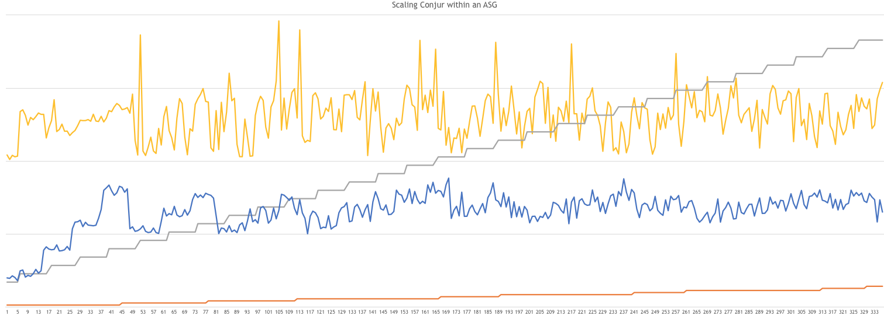
Elastic Scale Out Performance
140
105
70
35
0
Read Requests
(each step = 20/sec)
# Followers
Avg CPU%
Avg Latency (ms)

Slide 36
Production ocp deployment - performance
4 clusters, retrievals/hour/cluster w/ application cache (hash table, 15 min TTL)

Slide 37
Production OCP deployment – resource consumption
1 of 4 clusters, 5 followers/cluster

Slide 38
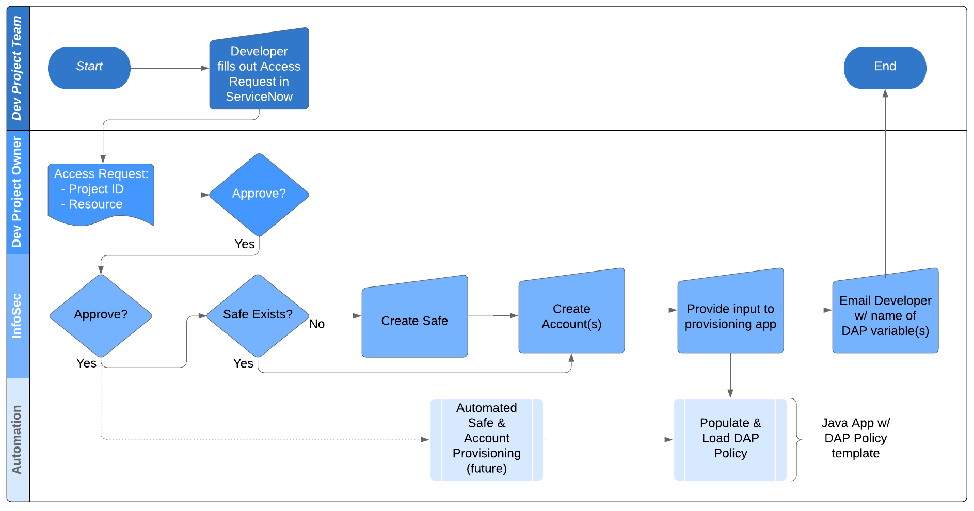
Reference Access Provisioning Workflow

Slide 39
Identity definition & permissions grants by app teams
Applied by Security team:
Managed by app team:
#======================
# APPTEAM1 ROOT POLICY
# AppTeam Policy Template where policy namespace = EPV safe name
# Creates admin identity to delegate policy mgmt and role to grant authn to app identities.
# This policy must be bulk-loaded with other root policies.
# Create one policy for each application team, named for the application team.
#======================
# Admin identity w/ CIDR limitation
- !host
id: appteam1_svc
# restricted_to: 172.17.0.3
# Create root policy for appteam1
- !policy
id: appteam1
owner: !host appteam1_svc
body:
- !group consumers
# Grant cross-platform authn to appteam1/consumers role
- !grant
roles:
- !group conjur/authn-iam/lab/consumers
- !group conjur/authn-azure/lab/consumers
- !group conjur/authn-k8s/lab/consumers
members:
- !group appteam1/consumers
# END APPTEAM1 ROOT
#======================
# APPTEAM1 IDENTITIES
# Policy defined & managed by the application team.
# Defines application identities “under” the app team’s root policy.
# Applied using appteam1_svc account at /appteam1 w/ --replace
#======================
- &hosts
- !host aws-app/475601244925/GenericReadOnly
- !host
id: azure-app
annotations:
authn-azure/subscription-id: a01ff134-ae78-4497-b11c-7a698736b8a0
authn-azure/resource-group: appteam1
authn-azure/user-assigned-identity: appteam1-UA-Identity
- !host
id: k8s-app
annotations:
authn-k8s/namespace: appteam1
authn-k8s/service-account: appteam1-app1
authn-k8s/authentication-container-name: authenticator
- !grant
role: !group consumers
members: *hosts
# Grant authn-k8s & safe access roles to app identity
- !grant
roles:
- !group /LabVault/Labs/LabSafe1/delegation/consumers
members:
- !host azure-app
# END APPTEAM1 IDENTITIES

Slide 40
Password change management w/ dual accounts
Initial State
Rotation 1
Synchronization
Rotation 2
Enterprise Password Vault
Active:
Inactive:
CPM Interval
Enterprise Password Vault
Inactive:
Active:
Sync Interval
Enterprise Password Vault
Inactive:
Active:
Grace Period
Enterprise Password Vault
Inactive:
Active:
acct1
acct1
acct1
acct1’
acct2
acct2
acct2
acct2
Synchronizer
Synchronizer
Primary
Primary
Primary
Primary
acct1
acct1
acct2
acct2
Follower
Follower
Follower
Follower
acct1
acct1
acct2
acct2
App A
App A
App A
App B
App C
App B
acct1
acct1
acct1
acct2
acct2
acct2
DB
DB
DB
DB
acct1
acct2
acct1
acct2
acct1
acct2
acct1’
acct2

Slide 41
Next Steps…

Slide 42
Authn-Azure: identity validated by Azure
Instance Metadata Service (IMDS)
http://169.254.169.254/metadata/identity/oauth2/token?api-version=2018-02-01&resource=https://management.azure.com/
Issues Azure access tokens (jwt)
Validates Azure access tokens for identities in Tenant
Tenant(s)
Provider URI: https://sts.windows.com/<tenant-id>
Subscription(s)
Resource Group(s)
“Group” Identity
CyberArk Conjur
System-Assigned Identities
User-Assigned Identities

Slide 43
Authn-k8s: identity validated by K8s
Cluster(s) Conjur Authenticator ID
Namespaces(s)
Namespace
Identities
Deployment(s) Stateful Set(s) Daemon Sets(s) Replica Set(s) Pod(s)
etc.
Service Account Identities

Slide 44
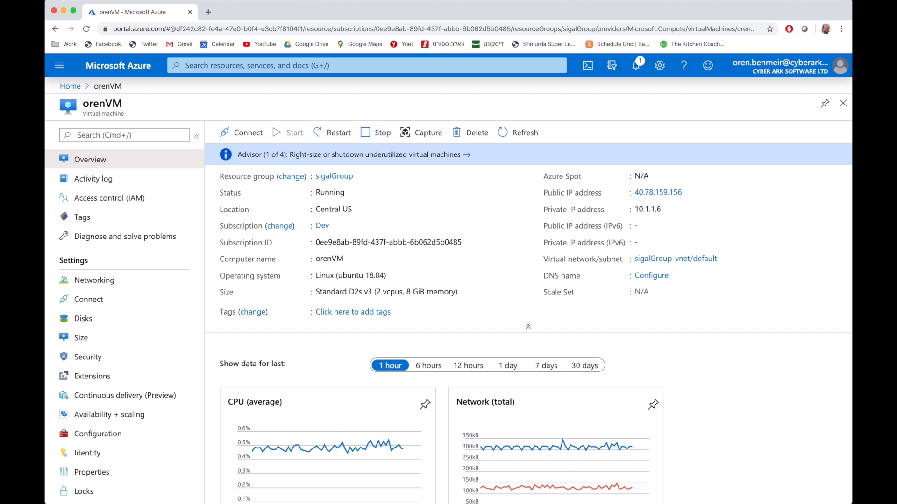
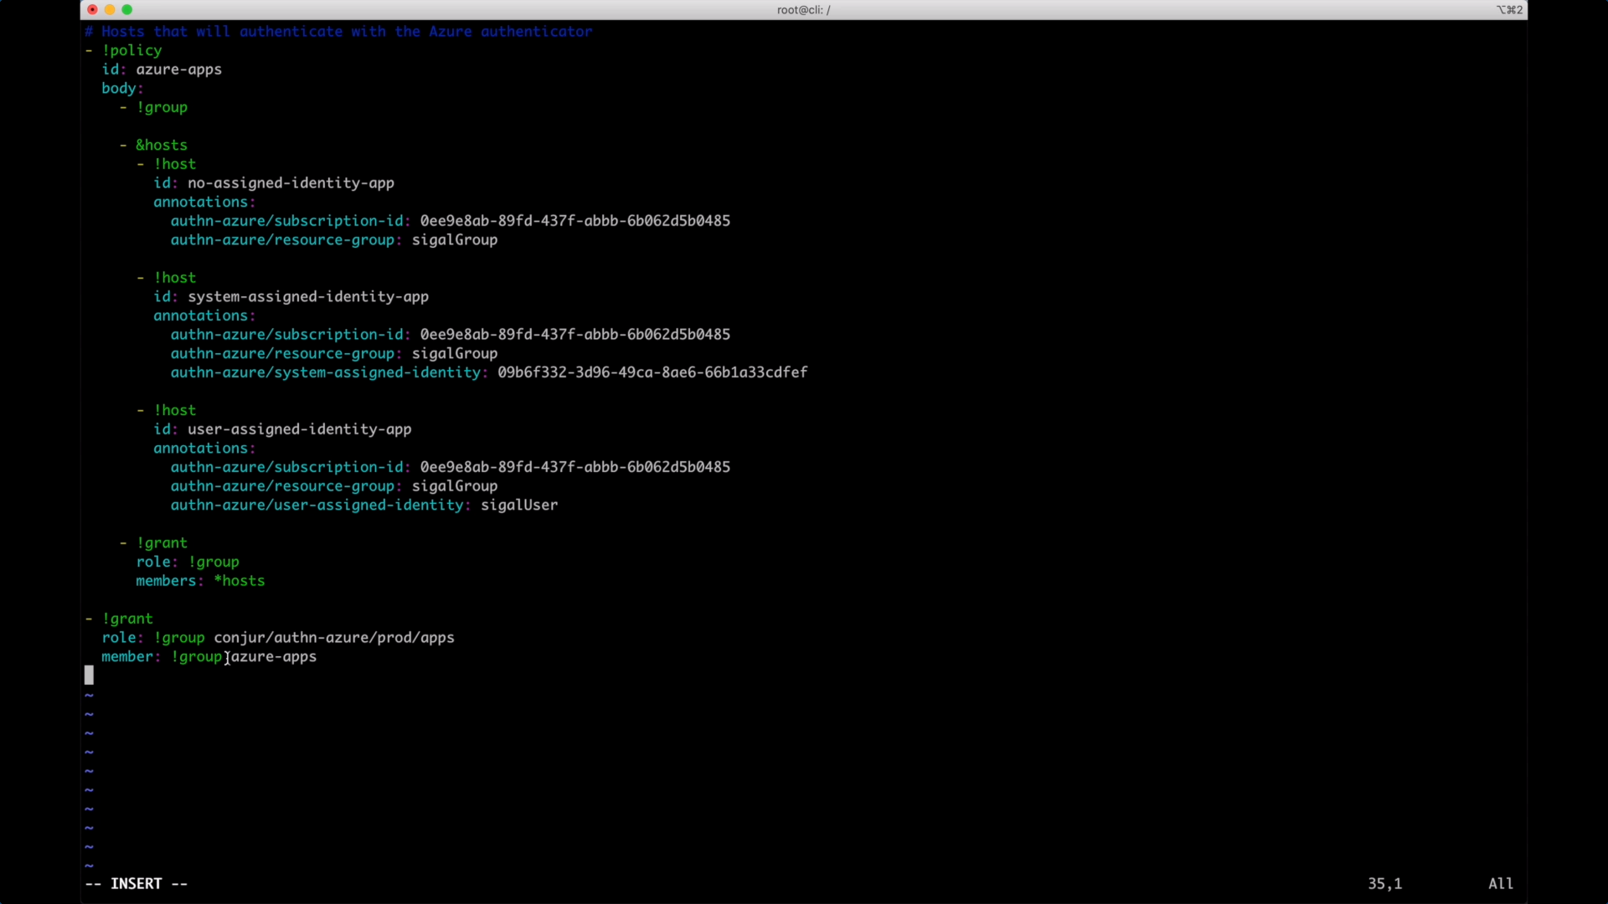
Azure Identity Option 1: Subscription ID + Resource Group
Identity definition in Conjur Policy yaml:

Slide 45
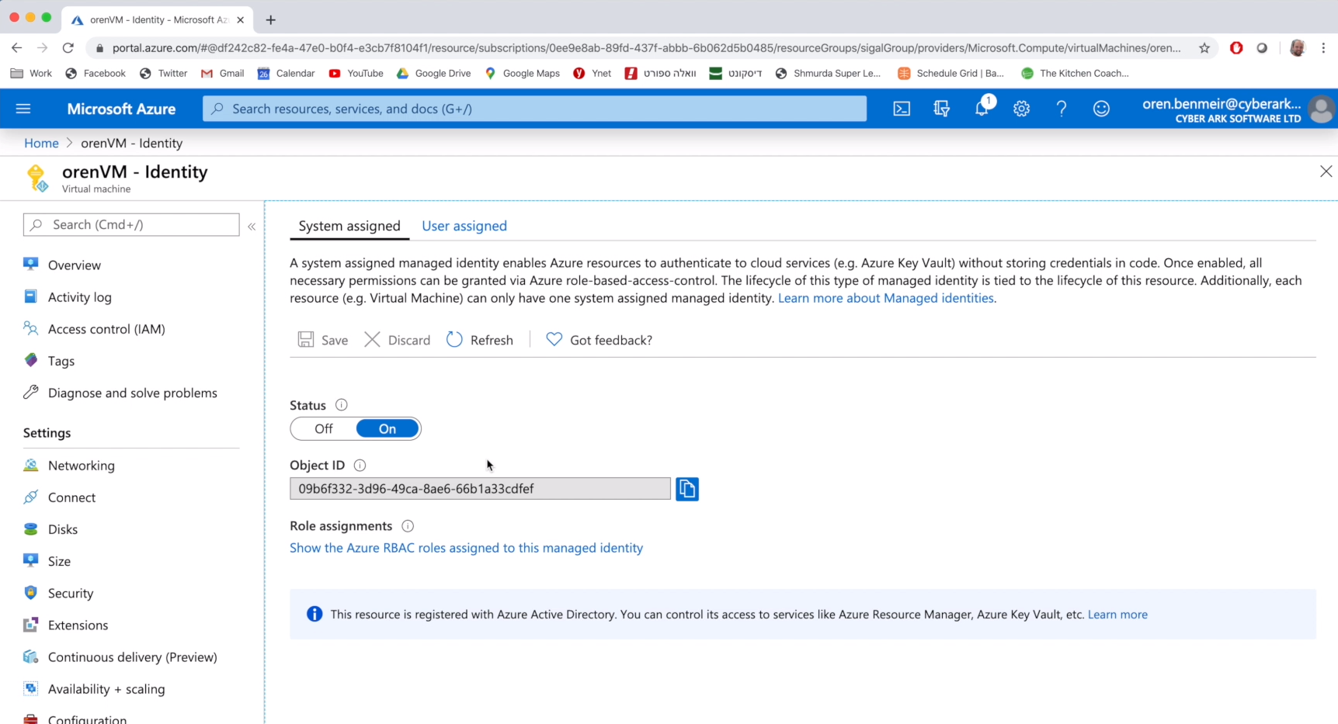
Azure Identity Option 2: Subscription ID + Resource Group + System Assigned Identity
Identity definition in Conjur Policy yaml:

Slide 46
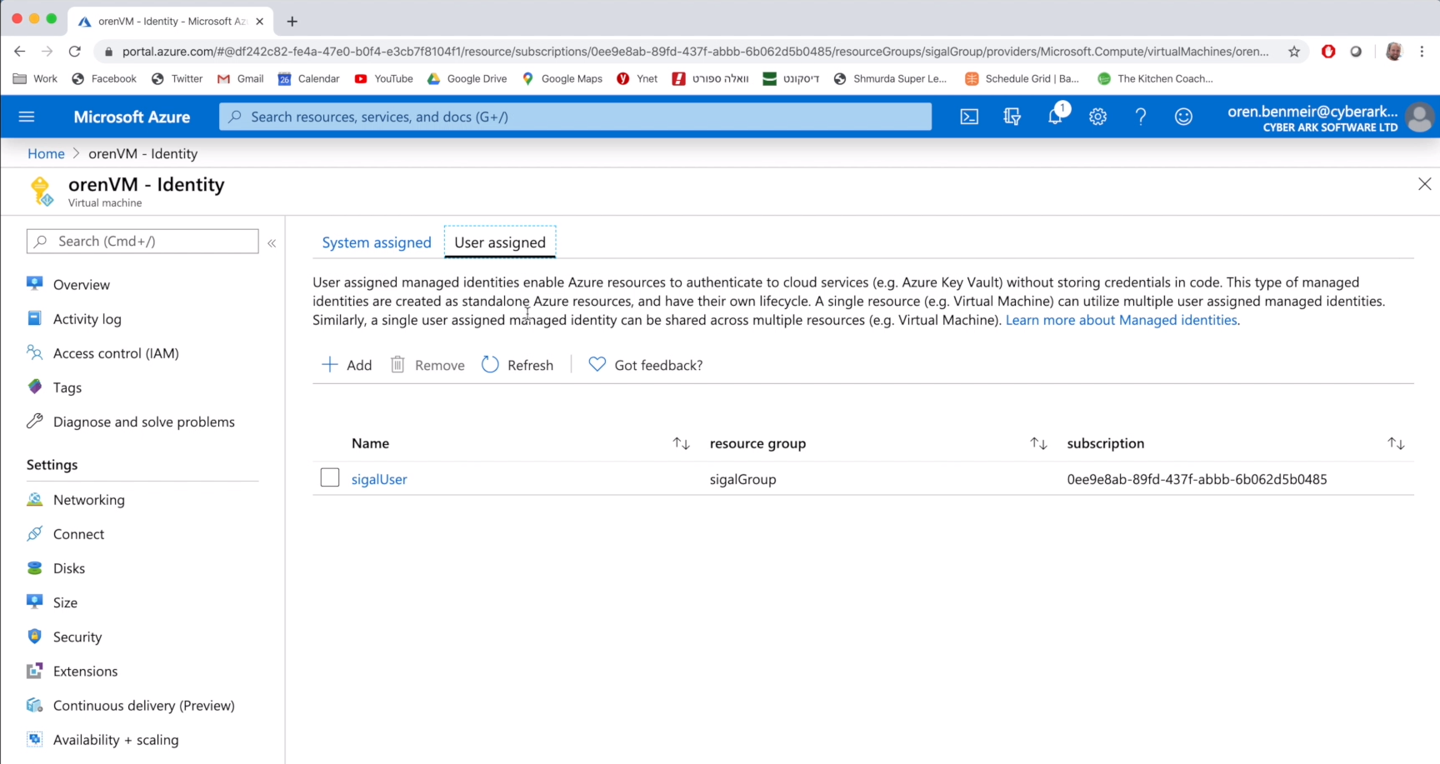
Azure Identity Option 3: Subscription ID + Resource Group + User Assigned Identity
Identity definition in Conjur Policy yaml:

Slide 47
Policy Detail: Configure Azure authenticator ID named “prod”
---
- !policy
id: conjur/authn-azure/prod
body:
- !webservice
- !variable provider-uri
- !group
id: apps
annotations:
description: Role for authn to authn-azure/prod webservice
- !permit
role: !group apps
privilege: [ read, authenticate ]
resource: !webservice
Create Azure authentication webservice endpoint named “prod”
Define variable to hold https://sts.windows.net/{tenant-id}
Define prod/apps role
Permit apps group role to authenticate to
conjur/authn-azure/prod webservice

Slide 48
Policy Detail: Identity Definitions
---
- !policy
id: my-apps
body:
- !group
- &my-hosts
- !host rgrp1
annotations:
authn-azure/subscription-id: a01ff134-ae78-4497-b11c-7a698736b8a0
authn-azure/resource-group: JodyTest
- !host rgrp1-sid1
annotations:
authn-azure/subscription-id: a01ff134-ae78-4497-b11c-7a698736b8a0
authn-azure/resource-group: JodyTest
authn-azure/system-assigned-identity: 48268f7c-9470-4aff-97a9-fa6c736479f1
- !host rgrp2-uid1
annotations:
authn-azure/subscription-id: a01ff134-ae78-4497-b11c-7a698736b8a0
authn-azure/resource-group: Conjur-Demo
authn-azure/user-assigned-identity: Conjur-demo-UA-Identity
- !grant
role: !group
members: *my-hosts
- !grant
role: !group conjur/authn-azure/prod/apps
member: !group my-apps
Create Azure Identities
Grant my-apps group role to Azure Identities
Grant prod/apps role to azure-apps role

Slide 49
Policy Detail: Resource definition & access grant
---
- !policy
id: secrets
- !group consumers
- &vars
- !variable sub1-rgrp1
- !variable rgrp1-sid1
- !variable rgrp1-uid1
- !permit
role: !group consumers
privilege: [ read, execute ]
resource: *vars
- !grant
role: !group secrets/consumers
member: !host my-apps/rgrp1
- !permit
role: !host my-apps/rgrp1-sid1
privilege: [ read, execute ]
resource: !variable secrets/rgrp1-sid1
- !permit
role: !host my-apps/rgrp1-uid1
privilege: [ read, execute ]
resource: !variable secrets/rgrp1-uid1
Create secrets/consumers group
Create secrets (AKA variables)
Grant consumers read/exec access
Grant consumers role to resource group identity
Grant specific identities access to specific secrets

Slide 50




Dynamically Verified Identity using K8s Platform Attributes
Whitelist identity (at Primary)
Credential Issuing Authority
Conjur policy
2) CSR w/ attributes
3) Validate Attributes
6) Authn
Follower
4) Legit
7) Share
Attribute Verifying
Authority
(K8s API)
5) Write Cert & Key
/access/ token
Authenticator
client container
Pod
Application container(s)

Slide 51
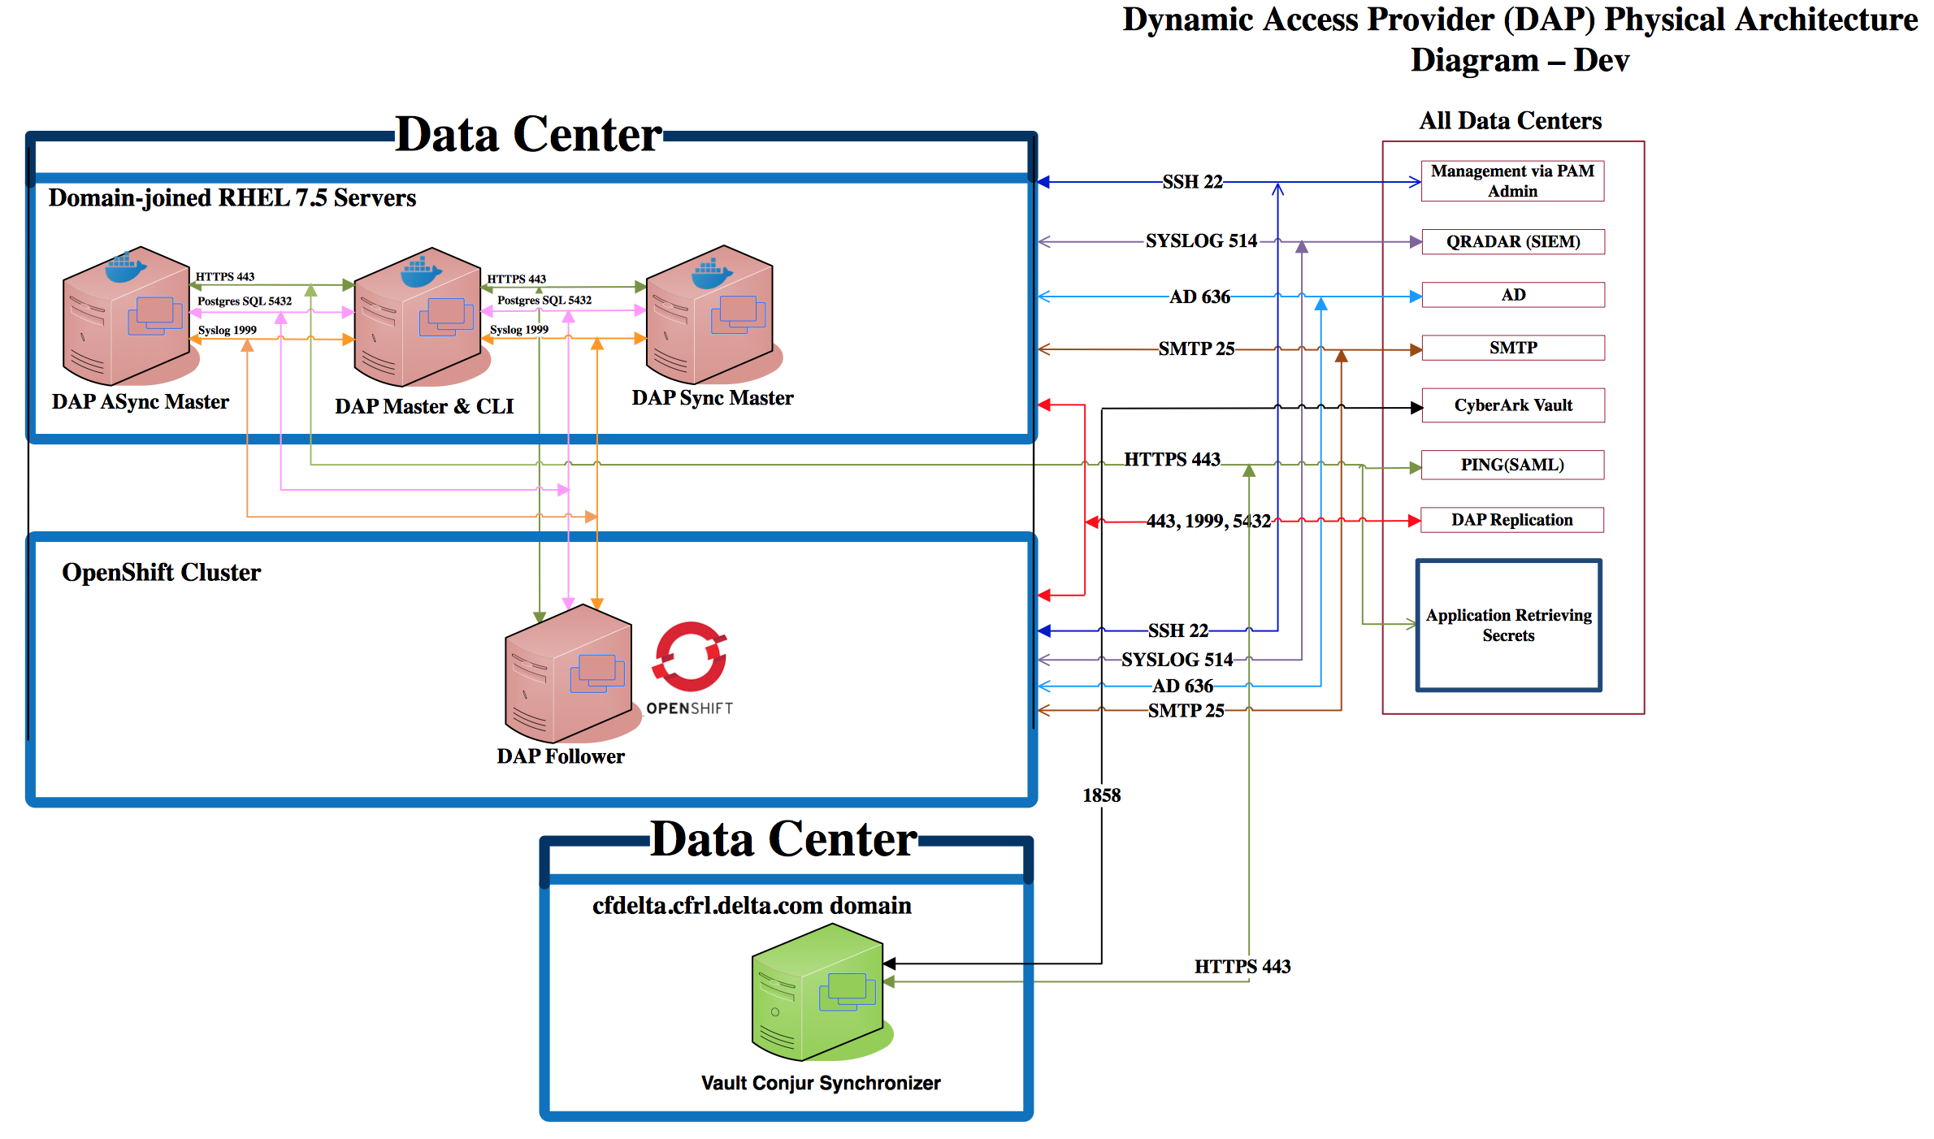

Slide 52
Crypto Details
Data at rest:
Database encryption uses 256-bit AES.
Master keys are encrypted with 256-bit AES.
Signed tokens use asymmetric RSA with 2048 modulus.
Password hashing is done with one-way bcrypt, with a work factor of 12.
Data in motion:
All access uses HTTPS (UI and API calls)
TLS 1.2 protocol only. No older TLS or SSL protocols supported.
Lowest strength cipher key size that can be negotiated is 128-bit, highest is 256-bit.
Diffie-Hellman key exchange within TLS sessions uses 3072-bit discrete logarithm group size, or 256-bit elliptic curve.

Slide 53
Conjur Policy 101
Variable: another name for a secret
Host: a single, authenticatable identity
Group/Role: aggregation of and permissions given to identities
RBAC: Hosts inherit the access granted to their Group/Role
Given:
A Group called AccountingApps w/ read-only access to Variable named db-password
A host called my-billingapp
If the AccountingApps Role is granted to my-appserver:
It is a member of the AccountingApps Group
It has the permissions that go with the Role (i.e. read-only access to db-password)

Slide 55
Secretless

Slide 56
INTRODUCING “Secretless”
Establishes proxied connections to resources w/o direct access to secrets.
Frees developers and applications from responsibility of managing secrets.
Reduces the threat surface of secrets
Handles rotation transparently
Does not change how clients connect to services
Allows use of standard libraries and tools.
Uses an extensible driver model to connect to backend resources.
For example:
HTTP
SSH (MITM and ssh-agent approaches)
SQL and NoSQL Databases
New drivers in development, inquire within to join the effort.

Slide 57


‘secretless’ workflow
Application flow (ongoing)
Monitor and control
Analytics, threat detection and response
Successful connection
Policy configuration
Rule creation
New rule request
Approval
Application configuration

Slide 58
design partners Program
Join a Secretless Design Partner forum
Monthly meetings of the forum that include:
Presentation of the progress, new features and use cases
Participate in feedback and validation discussions with other design partner customers
Live and direct Q&A session
Getting early version for trial
Open Communication channel with R&D and PMs
Influence and become part of the future security vision from CyberArk
Option to speak on the solutions in events and become a Secretless pioneer

Slide 59
Stolen secrets? Inconceivable!

Slide 61
Application access management – 4 solutions
Agent-Based
Agentless
Credential Provider (CP)
Architecture: Local agent on host w/ app
Best use: Long-running, monolithic apps
Pros: Strong authn, no secret-zero, cred caching
Cons: Install/config not easily automated
Licensed: Per agent/IP-address
Central Credential Provider (CCP)
Architecture: Central server (CP + IIS)
Best use: Multiple, distributed apps
Pros: No agent, client cert authn, remote access via REST calls, cred caching at server
Cons: Secret zero (AppID, cert)
License: Per server pair per location (DC, cloud region)
Application Server Credential Provider (ASCP)
Architecture: Local agent in app server
Best use: WebSphere, WebLogic, Jboss, or Tomcat Java apps
Pros: Strong authn, no secret-zero, cred caching, automatic DB connection pool management
Cons: Install/config not easily automated
Licensed: Per agent/appserver
Dynamic Access Provider (Conjur) (AKA Conjur)
Architecture: Multi-node cluster (Docker containers)
Best use: CI/CD tools, micro-service/cloud/K8s apps
Pros: Strong authn, REST access, scalable, no secret zero
Cons: More complex
License: Per Follower-pair per location (DC, cloud region, k8s cluster)

Slide 62

AIM Solutions
Credential Provider
Application Server Credential Provider
Windows, *nix, zOS, iSeries
Java, .Net, CLI, C/C++, COM
Local caching
Strong authentication
Transparent data-source credentials management for WebSphere, WebLogic, Tomcat, JBoss
Central Credential Provider
“Push” solutions for changing passwords in target systems
Light, Agentless, Web service based,
for Non mission critical applications and scripts
Available for any EPV customer

Slide 63
Evolution of Application Access Manager
Monolith
Virtualized
Containerized
Micro Services
All need access to secrets and other credentials. Some are very short-lived.
Increased: agility, pace, automation, automation tools

Slide 64


Secrets Management
From mainframe to microservices
Enterprise
Open Source
CyberArk Application Access Manager
Credential Provider
App Server Credential Provider
Central Credential Provider
Dynamic Access Provider
Windows/ *nix / zOS
(agent)
Application Servers (agent)
Windows/ *nix
(agentless)
Devops, Cloud and Containers
Notes:
Going forward, these are the three areas of focus from an innovation point of view

Slide 65



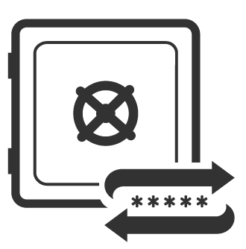



Credential provider
High performance and availability
SDK
X
Application
Credential Provider
CyberArk Vault
Application Identity Manager’s secure local cache stores retrieved credentials for high performance and availability
The secure local cache enables quick retrieval of credentials
Application Server
Username = GetUserName()
Password = GetPassword()
Host = GetHost()
ConnectDatabase(Host, Username, Password)
In case a network outage should occur, credentials will always be available from the secure local cache
Target System

Slide 66

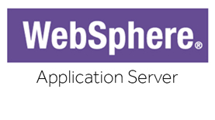



Application Server Credential Provider
DATA SOURCE
REFERENCE
API CALL
Client Application
Application Server
ASCP
Local secure caching
High-availability
Enhanced auth & anti-tampering
J2EE App Sever
Minimal code changes
DataSource customerDataSource = (DataSource)
context.lookup("java:comp/env/jdbc/customer_db")
Username = GetUserName()
Password = GetPassword()
Datasource
CyberArk Vault

Slide 67
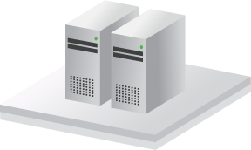




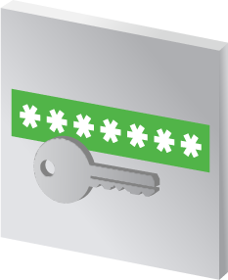






Traditional Application Access: A high level perspective
Application Identity Management
Applications
Application Servers (WebSphere, Weblogic, etc.)
Secure Storage
Databases
Security Appliances
*****
Applications
Unix Servers
CyberArk Vault
Password and SSH Key Rotation
Network Devices
Servers
Applications
Windows Servers
Username = GetUserName()
Password = GetPassword()
Host = GetHost()
ConnectDatabase(Host, Username, Password)
Username =
Password =
Host =
ConnectDatabase(Host, Username, Password)
“app”
“y7qeF$1”
“10.10.3.56”
Websites/ Web Apps
Cloud Infrastructure
Applications
Mainframe Servers
Applications
Desktops
Notes:
Applications can reside anywhere in an organization, be it servers or desktops. Unix Servers, Windows Servers, Mainframes, Application servers, such as WebSphere, Weblogic, etc.
<CLICK 1>
Typically, these applications will need to connect to a remote resource, such databases, web application, cloud infrastructure, and even simply other servers.
In order to connect and communicate with these resources, the application must use credentials, and as we saw earlier these credentials are naturally hard-coded into the application code, which expose them to attackers and insider threats.
<CLICK 2>
Moreover, these credentials are almost never changed, because they have been hard-coded into tons of applications throughout the organization.
How does CyberArk overcome these challenges?
First thing’s first – remove the hard-coded credential from the application code.
CyberArk Application Identity Manager enables the complete elimination of hard-coded and embedded credentials in applications by replacing them with SDKs. The credential are stored in Vault, and are retrieved using the SDK inside the application code.
Credentials, be it password or SSH keys, can then be easily rotated based on the organization policy and the application will transparently use these new credentials whenever required,
Let’s have a look at how this works.
Attackers or malicious insiders will eventually get access to these credentials, so what we need to do is store them in the Vault
<CLICK 3>
This will secure them and enable their frequent rotation
Then, we must get rid of these hard-coded credentials <CLICK 4> and replace them with SDK calls
<CLICK 5>
This will enable applications to retrieve the credentials stored and secured in the Vault
<CLICK 6> When a credential is required by an application it is retrieved from the Vault to the application, and then used to authenticate to whichever resource it is required.
And this summarized the high-level concept of AIM – Application Identity Manager.
Let’s now go on and discuss all of AIM’s benefits
<CLICK 7>

Slide 68



But why change code? J2EE
Integration with Java Application Servers enables the transparent management of datasource credentials for: WebSphere, WebLogic, JBoss, Tomcat
Requires no code changes to the J2EE application. One-time configuration change to the application server.
Server
WebSphere
J2EE
Application
Database
Application Server Credential Provider
CyberArk Vault
Notes:
The third solution included in AIM, is a solution for Java Application Servers.
This is a solution for the transparent management of datasource credentials, the credentials used by the application servers to connect to databases and other assets at the heart of the enterprise.
<CLICK 1>
Among the SDKs CyberArk AIM offers is a Java SDK, through which Java applications can retrieve credentials, as we have seen in the previous slides.
But why change the code of all application when you can make a one time configuration change in the Application Server itself?
CyberArk has developed and patentized an innovative solution that eliminates hard-coded credentials in Java Applications servers without needing to change a single line of code, which as we know, can be a big challenge to orchestrate.
<CLICK 2>
The Application Server Credential Provider is installed on the Java Application Server, just like the Credential Provider we saw in the previous slides.
<CLICK 3>
Similar to the Credential Provider, everytime the Java application requires a credential, it is retrieved from the Vault, stored in the cache, and the connection is established by the Java Application Server.
The credential never makes it to the application itself.
The Application Server Credential Provider is very popular for the beginning of AIM projects, since it requires no code changes, and is very easy to implement.

Slide 69

But why change code? J2EE
Integration with Java Application Servers enables the transparent management of datasource credentials for: WebSphere, WebLogic, JBoss, Tomcat
Requires no code changes to the J2EE application. One-time configuration change to the application server.
Server
WebSphere
J2EE
Application
Database
Application Server Credential Provider
CyberArk Vault
Notes:
The third solution included in AIM, is a solution for Java Application Servers.
This is a solution for the transparent management of datasource credentials, the credentials used by the application servers to connect to databases and other assets at the heart of the enterprise.
<CLICK 1>
Among the SDKs CyberArk AIM offers is a Java SDK, through which Java applications can retrieve credentials, as we have seen in the previous slides.
But why change the code of all application when you can make a one time configuration change in the Application Server itself?
CyberArk has developed and patentized an innovative solution that eliminates hard-coded credentials in Java Applications servers without needing to change a single line of code, which as we know, can be a big challenge to orchestrate.
<CLICK 2>
The Application Server Credential Provider is installed on the Java Application Server, just like the Credential Provider we saw in the previous slides.
<CLICK 3>
Similar to the Credential Provider, everytime the Java application requires a credential, it is retrieved from the Vault, stored in the cache, and the connection is established by the Java Application Server.
The credential never makes it to the application itself.
The Application Server Credential Provider is very popular for the beginning of AIM projects, since it requires no code changes, and is very easy to implement.

Slide 70


Central credential provider
Centralized, agentless approach
HTTPS
Application “Server”
Central Credential Provider
Agentless, web service based application secrets management solution
Eliminates risk from hard-coded application credentials
Platform agnostic
Alleviates deployment overhead
Username = GetUserName()
Password = GetPassword()
Host = GetHost()
ConnectDatabase(Host, Username, Password)
Target System
CyberArk Vault

Slide 71
Automation Anywhere: Integration Overview & Benefits
Challenges without CyberArk CCP integration
Sensitive data stored in two places:
CyberArk EPV & Automation Anywhere Credential Vault
Extra effort in maintaining data security at two places.
User access to copy/paste sensitive data from CyberArk to Automation Anywhere
Sensitive exposed to multiple users
Benefits of CCP integration
Credentials securely stored in CyberArk EPV
CyberArk manages access to & automatically rotates credentials
No User access - credentials only accessible to authentication bots
Credentials securely retrieved as needed for robots to perform their functions
All access captured in audit logs
Client stays in compliance with corporate policies and industry guidelines
Integration implemented and supported by Automation Anywhere

Slide 72
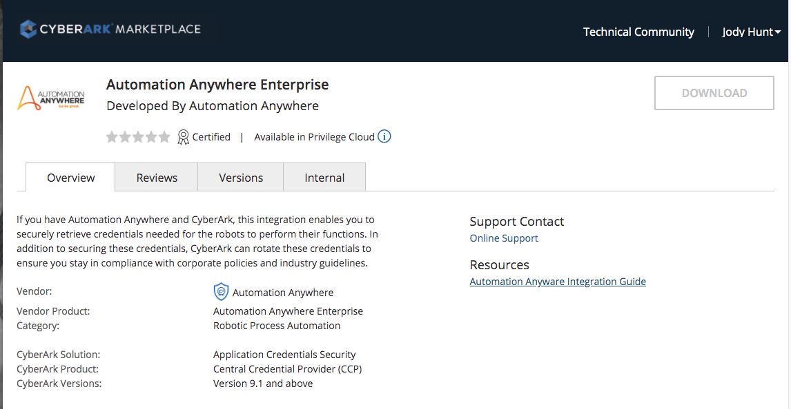
Automation Anywhere: Integration offered in CyberArk Marketplace

Slide 73
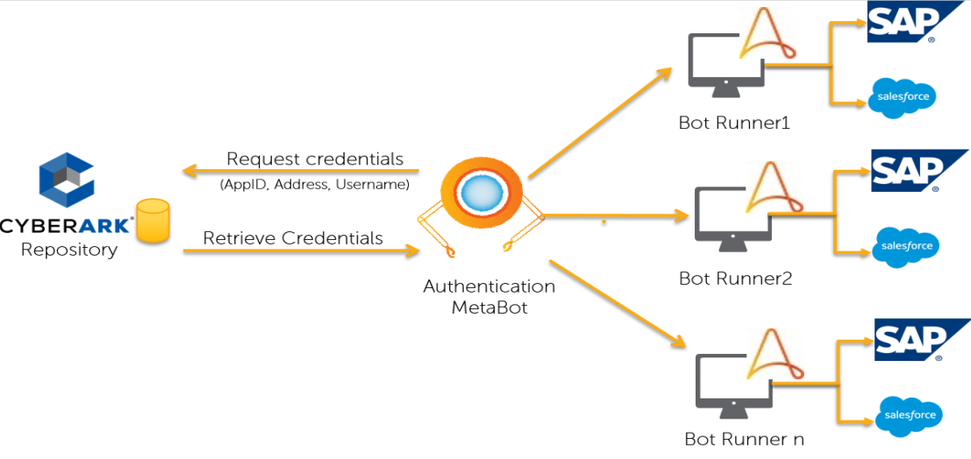
Automation Anywhere: Solution architecture with CyberArk CCP

Slide 74
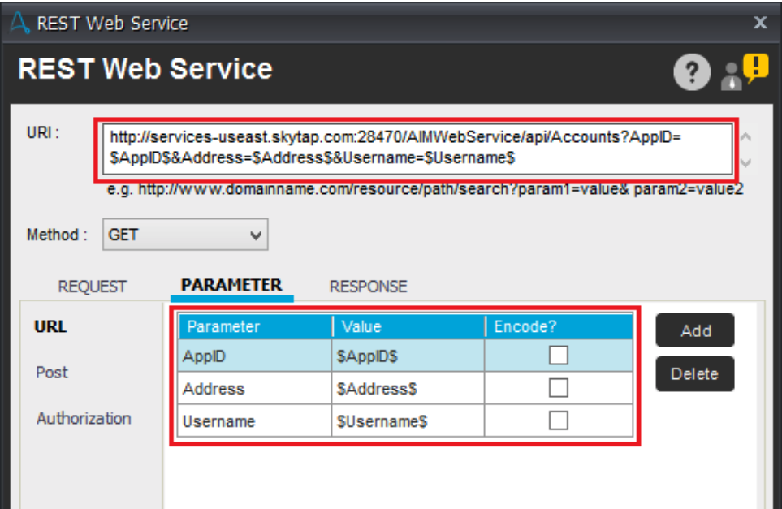
Automation Anywhere: Configuring Metabot connection to CCP

Slide 75
Secure Secrets For Applications Running In Pivotal Cloud Foundry

Slide 76
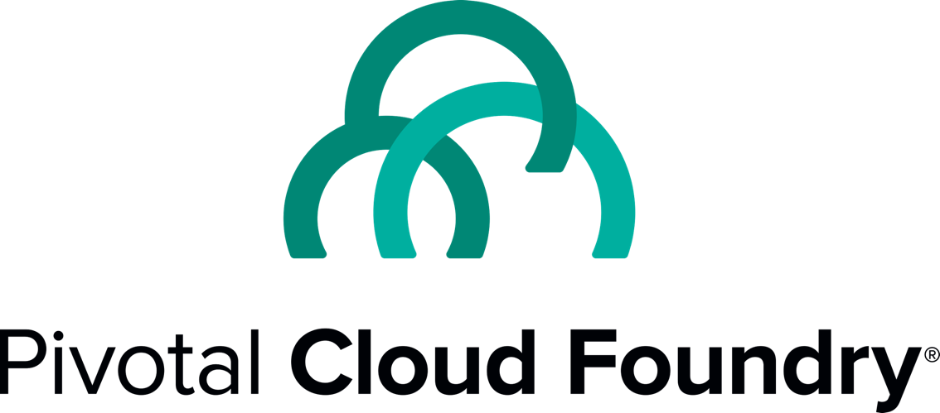
Pivotal Cloud Foundry
Industry leading Platform-as-a-service.
Enables high velocity continuous delivery of applications.
Simplifies operations by offering a nearly complete ecosystem for developing applications.
Large footprint in the enterprise. Customers include CITI, The Home Depot, JPMC, Boeing, and many more
Notes:
Key takeaway: CyberArk and Pivotal are working together to secure Pivotal Cloud Foundry.

Slide 77
Key Benefits
Secrets managed by CyberArk and Conjur are delivered securely to applications running in Pivotal Cloud Foundry
No developer impedance. Seamlessly integrated into the PCF Environment and Developer Workflow.
Security teams enabled to bring security best practices to PCF and meet compliance requirements

Slide 78
Components
Open Service Broker Within the Pivotal Cloud Foundry ecosystem, the Service Broker pattern has emerged as the standard for integrating services. The Service Broker pattern implements the Open Service Broker API standard it is backed by the Linux Project Foundation.
Summon Buildpack Buildpacks provide framework and runtime support for apps. Buildpacks typically examine your apps to determine what dependencies to download and how to configure the apps to communicate with bound services. The Summon Build Pack installs and configures Summon. Summon is a an lightweight, open source tool provided by CyberArk for securely injecting secrets into a process.
Conjur Conjur is an enterprise-ready secrets management solution for cloud and DevOps environments. Open source version of Conjur is available at conjur.org.

Slide 79
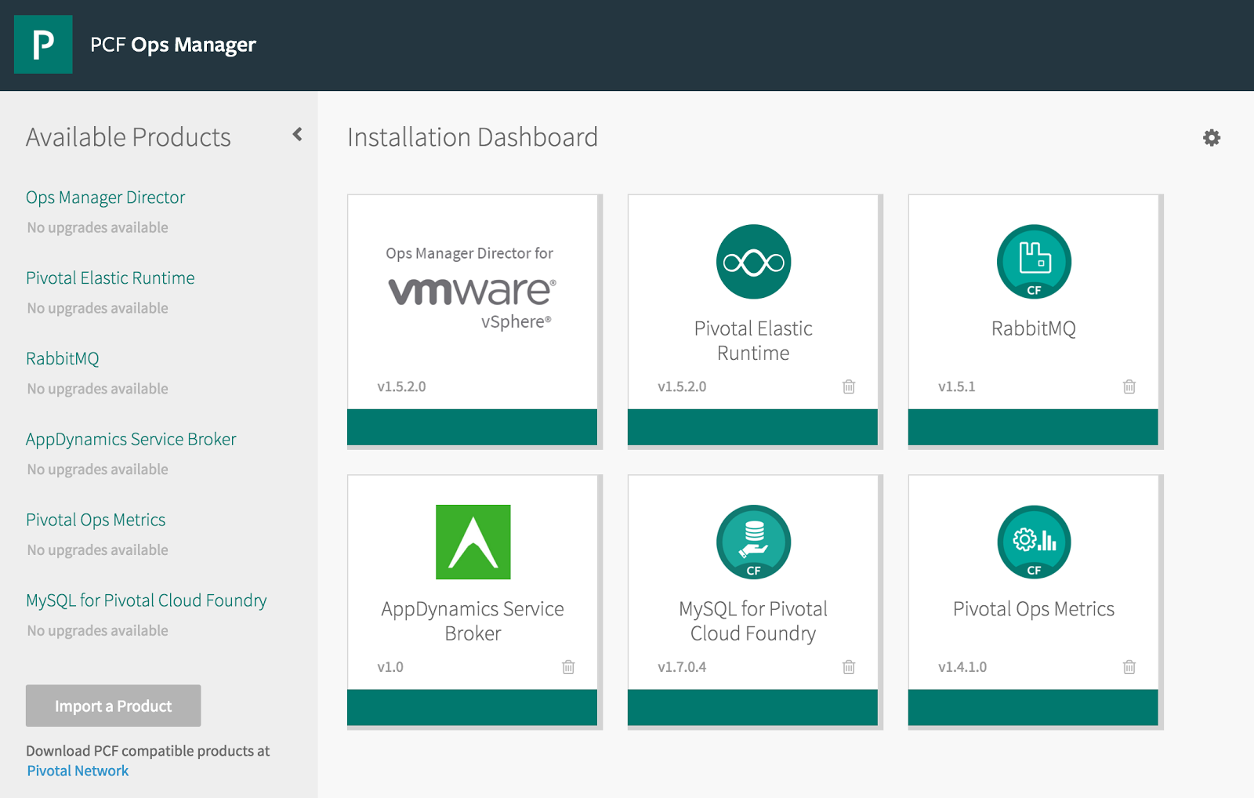
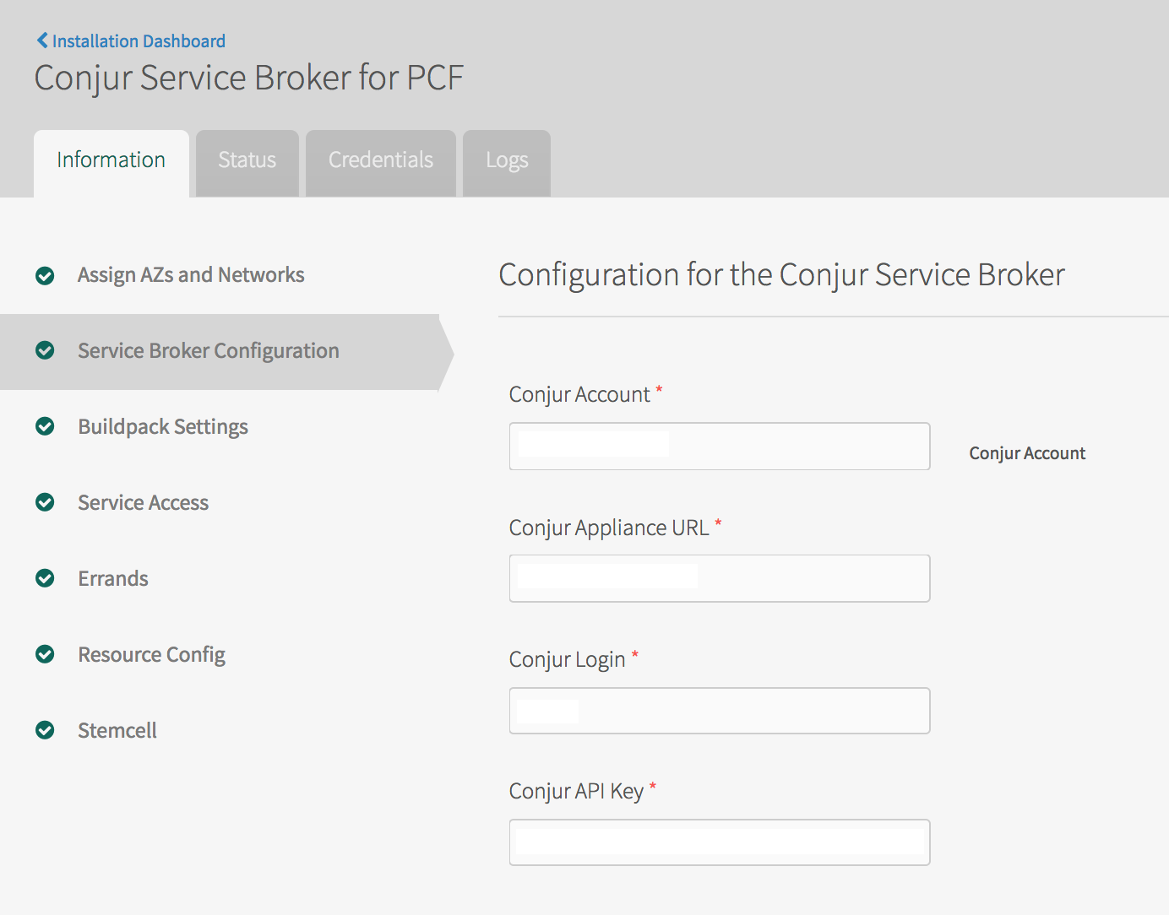
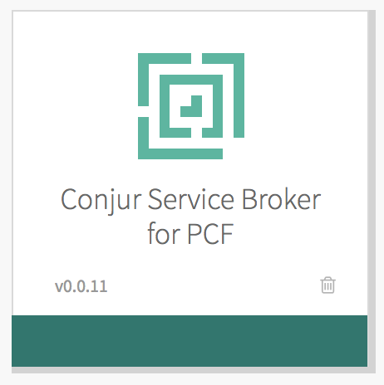
Service is installed and configured via the Ops Manager
Installing and Configuring CyberArk Conjur Service Broker for PCF
Notes:
Key takeaway: Install the Conjur service like you would any other PCF service.

Slide 80
Developer Workflow
Prepare the Application by adding a secrets.yaml file with references to the secrets your application needs.
Create a service instance in the space where you intend to deploy the application.
Add the instance name to your application manifest (if you are using manifest)
Push the application without starting it
Update Conjur policy grants with binding id for your application
Restage the application
Using CyberArk Conjur Service Broker

Slide 81
Under The Hood
Pivotal Cloud Foundry
4 Create Identity for Application
CyberArk Conjur Tile
1. Install & configure the service with the Conjur tile
CyberArk-Conjur Service Broker
Summon Buildpack
5. Issue credentials
6. Pass credentials
3. Bind Application to Service
CyberArk-Conjur
Instance
2. When the application is started for the first time the Buildpack installs Summon
Application
8. Authenticate and request values
7. UpdateConjur policy to grant secret access to the app’s identity
CyberArk Summon
9. Inject secret values
Notes:
The source of a Conjur hostname in PCF (e.g. pcf/54ddaf3b-1ff6-488e-bdab-655f84b3ffbe) is the binding ID, which is unique to the application's Service Instance's binding to the Conjur Service Broker. The Service Instance and binding ID are created when the application binds to the Service Broker on initial push. The host identity is dynamically created in Conjur using a host factory, with the hostname name as "pcf/<binding ID>" and an associated API key. Those credentials (hostname & API key) are cached as part of the application's environment in the VCAP_SERVICES environment variable credentials attribute. The binding ID is unique to the push of the app, which may have multiple instances sharing the same Service Instance and using the same hostname/API key for Conjur authentication (i.e. the application instances all share the same identity). Restarting an app instance or deploying new instances doesn't refresh the binding. That only changes if the app is explicitly unbound from the service instance and is subsequently re-pushed (see https://docs.cloudfoundry.org/devguide/services/managing-services.html#unbind).

Slide 82
Attribute-Based Authentication in Container Orchestration Platforms
Notes:
Today I’ll be talking about securing privileged access in the cloud at scale, and managing secrets within the DevOps Continuous Integration and Deployment Pipeline.

Slide 83
Design Requirements
Support running Secret Service inside or outside of the container platform itself
Inside: As a fully managed service for scalability, distribution, monitoring, etc.
Outside: In order to alleviate security concerns about having the Master node physically available (even if encrypted at rest) inside the container platform environment.
Be stateless
New clients must be able to authenticate without requiring writing any data to a Conjur master or waiting for replication.
Be horizontally scalable
Support as many Authenticators as needed may be run in order to authenticate all the clients.
Provide MFA w/ strong authentication based on multiple requestor attributes
At least one of these factors must use a different communication channel from the others.
Support a time-limited access credential
One that can be set to quickly expire and which can be frequently refreshed.
Protect access credentials against unauthorized use
e.g. a credential can’t be stolen and used elsewhere in the network.
Provide a consistent user experience across all supported platforms.

Slide 84



Container Authentication Reference Architecture
1
Developer or cluster admin whitelists app via Conjur policy
2
Orchestration service launches application instance
1
3
Authenticator for application instance submits CSR to Conjur Authentication service
3
2
4
Conjur validates attributes in CSR (network origin, cryptographic credential, instance metadata) with orchestration service
4
5
5
If valid, Conjur writes authn creds to container via orchestration service
Notes:
Here’s how we generate the certificate - https://github.com/conjurinc/authn-k8s/blob/master/app/models/pki/ca.rb
The key and cert are generated here - https://github.com/conjurinc/authn-k8s/blob/master/app/controllers/login_controller.rb#L8
Then installed to the client Pod - https://github.com/conjurinc/authn-k8s/blob/master/app/controllers/login_controller.rb#L10
The “install” script is just a bash script - https://github.com/conjurinc/authn-k8s/blob/master/app/controllers/login_controller.rb#L17
And we run the script using a programmatic version of `kubectl exec` - https://github.com/conjurinc/authn-k8s/blob/master/app/controllers/login_controller.rb#L30
Which is a WebSocket client - https://github.com/conjurinc/authn-k8s/blob/master/app/models/kubectl_exec.rb#L16
Then when we issue the token, it’s encrypted with the certificate using PKCS7 https://github.com/conjurinc/authn-k8s/blob/master/app/controllers/authenticate_controller.rb#L11
The final Secret-0 design changes this somewhat, but not much - https://docs.google.com/document/d/1Id6Y5aW4mPBpa8yLWiAjx01oQ99oJqxLmOpkwhtsrqE/edit#heading=h.63mvdn9i1vb9
And, the CA certificate and key come from Conjur variables - https://github.com/conjurinc/authn-k8s/blob/master/app/controllers/login_controller.rb#L34

Slide 85
General Design
The Authenticator Service supports two operations:
Login
Performed once by each Client to obtain a signed certificate.
The login method resists identity spoofing by installing the signed certificate onto the Client application using a Container Platform Engine API.
Authenticate
Performed many times by each Client application in order to obtain a short-lived access token.
Once the Client application has logged in and obtained its signed certificate, it uses the certificate to authenticate
Authentication returns a short-lived access token which is IP-restricted and encrypted by the client's public key.
The IP restriction prevents the token from being used outside of the container cluster.
The encryption ensures an attacker cannot use a token without having access to the private key as well, which is stored in the client container's memory.

Slide 86
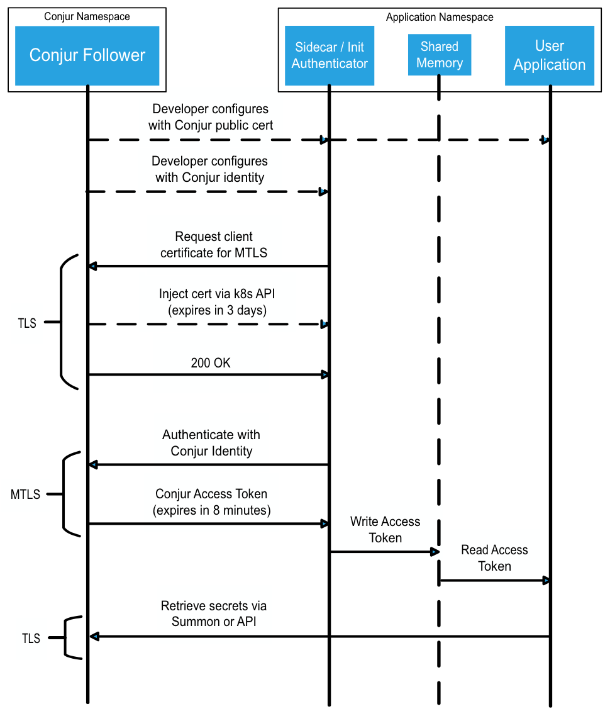
Openshift/K8s authn flow
CyberArk Conjur Service
authentication client container
Shared memory volume
application container
Deployment
manifest
Login
Authentication
Secrets retrieval

Slide 87
Multi-Cluster Distribution w/ Central Administration (not currently supported)
Dev LOB1
Dev LOB2
Dev LOB3
Prod
Enterprise
Vault
LOB 3 Safe
Test LOB1
Test LOB2
Test LOB3
LOB 1 Safe
LOB 2 Safe

